Slide 1


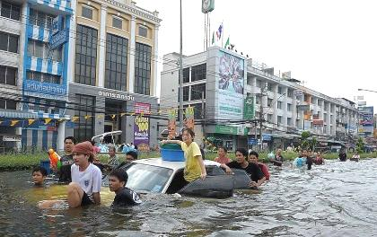
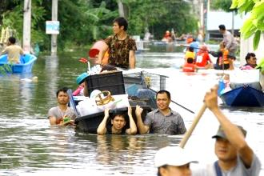
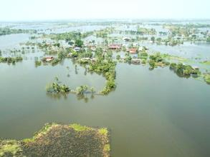
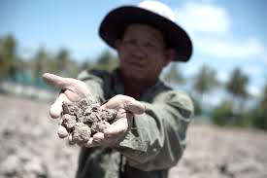

National vision on flood and drought management
Dr. Somkiat Prajamwong
Secretary - General
Office of the National Water Resources (ONWR), Thailand
6th June 2018
United Nations Conference Centre, Bangkok, Thailand
Notes:
Good afternoon ladies and gentlemen.
It is my honour to be invited as a presenter for National vision on flood and drought management.

Slide 2





Past experience : Extreme Flood and Drought
“Average rainfall is 46% lower than normal”
“Impacted of 13.43 Million people ”
Meteorological
drought
“Impacted of 4.04 Million households ”
“Water levels at 45% of whole reservoirs capacity”
“Damage cost THB 1,440 billion”
Hydrological
drought
“Rain-fed rice plantations is suffering in the major basin i.e. Chao Phraya river basin”
“GDP revised down from 2.6 % to 1.0 %”
Agricultural
drought
Source: Bank of Thailand /World Bank
2
Notes:
Thailand has occurred extreme flood in 2011 and extreme drought in 2014-2015.
The impacts of flooding include loss of human life, damage of properties and impact of agriculture, but those cannot avoid these situation. As the result, damage cost in 2011 was THB 1,400 billion (USD 45.6 billion) that is the highest record history.
In case of drought, we have more than 30 water-related agencies, and each agency use its own data to predict and play with drought management.
The Ministry of Agriculture and Cooperatives on 24 January 2017 sought Cabinet approval for 8 measures on water allocation. The measures involve efficiency in water use, an increase in the volume of usable water, and the development and rehabilitation of drought-hit farmland. Community plans will be worked out to ease drought conditions. Public relations campaigns will be stepped up on the issue, and knowledge dissemination on drought risk reduction will be emphasized.
The Department of Royal Rainmaking and Agricultural Aviation worked on rainmaking operations to increase water levels in various reservoirs, thus helping ease drought conditions in many areas across the country

Slide 3


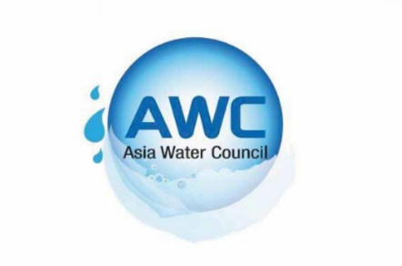
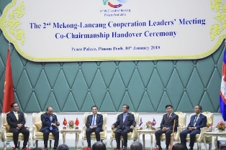
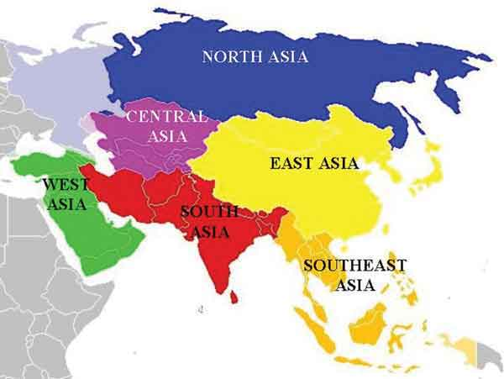
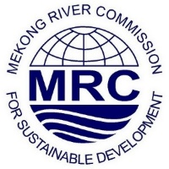
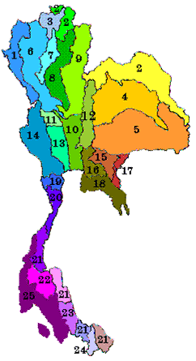




Future Vision : Strategy and Policy
20-Year Thailand’s Strategic Plan
Strategy Plan for Water Resources Management
National Water Resources Committee ONWR (Secretariat)
Data Base
Water Resources Management
Strategy and
Master Plan
Work Plan + Budget
3

Slide 4

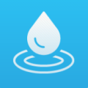


3 Mechanisms of Water Resources Management
Linkages
Policy
Management
• The 20-Year National Strategy
Water Resources Management
• The National Water Resources Committee
• A 12-year water resources management strategy
• Office of the National Water Resources
Linkages
Linkages
Act
Water Resources Act + Ministerial Regulations
4

Slide 5




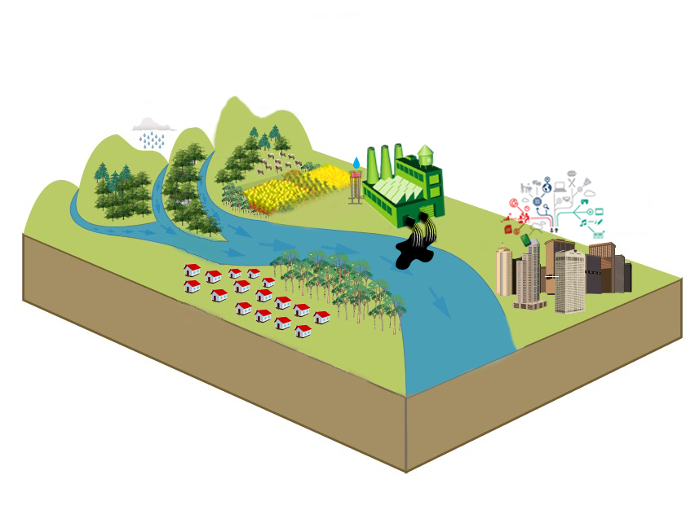





Policy : Water Resources Management Strategy 2015-2026
Creation for Water Security for Production (Agri. + Ind.)
9,500 million m³ (2,358 million m³)
Area 1.36 million Ha. (382,400 Ha.)
Water Quality Management
248 systems
(53 systems)
Upstream Forest Conservation and Soil Erosion Prevention
Area 763,200 Ha. (58,956 Ha.)
Management
Organizations
Legal of water resource
Decision Support Data System
Public relations and participation
Water Management for Consumption
7490 villages (7,234 vilages)
Flood Management
Protection Flood 168 cities (63 cities)
Dredging 870 km. (292 km.)
5

Slide 6
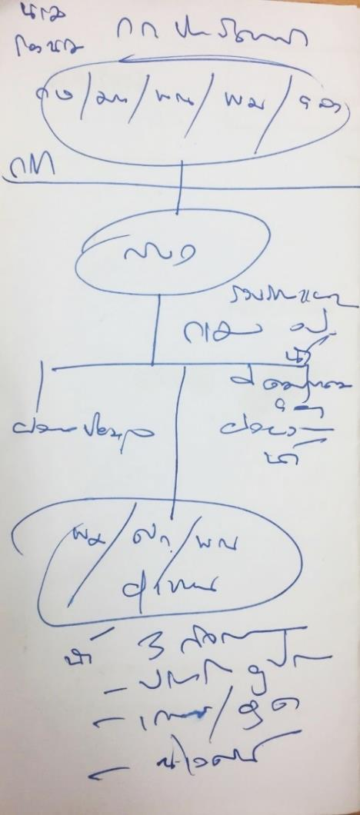
Management : National Water Resources Committee
PM
DPM
MOAC/MNRE/MIF
ONWR
Data Base
Work Plan/Budget/
Management
Operators
Water for 3 Activities
Consumptions
Agriculture/Industry
Ecology
6

Slide 7
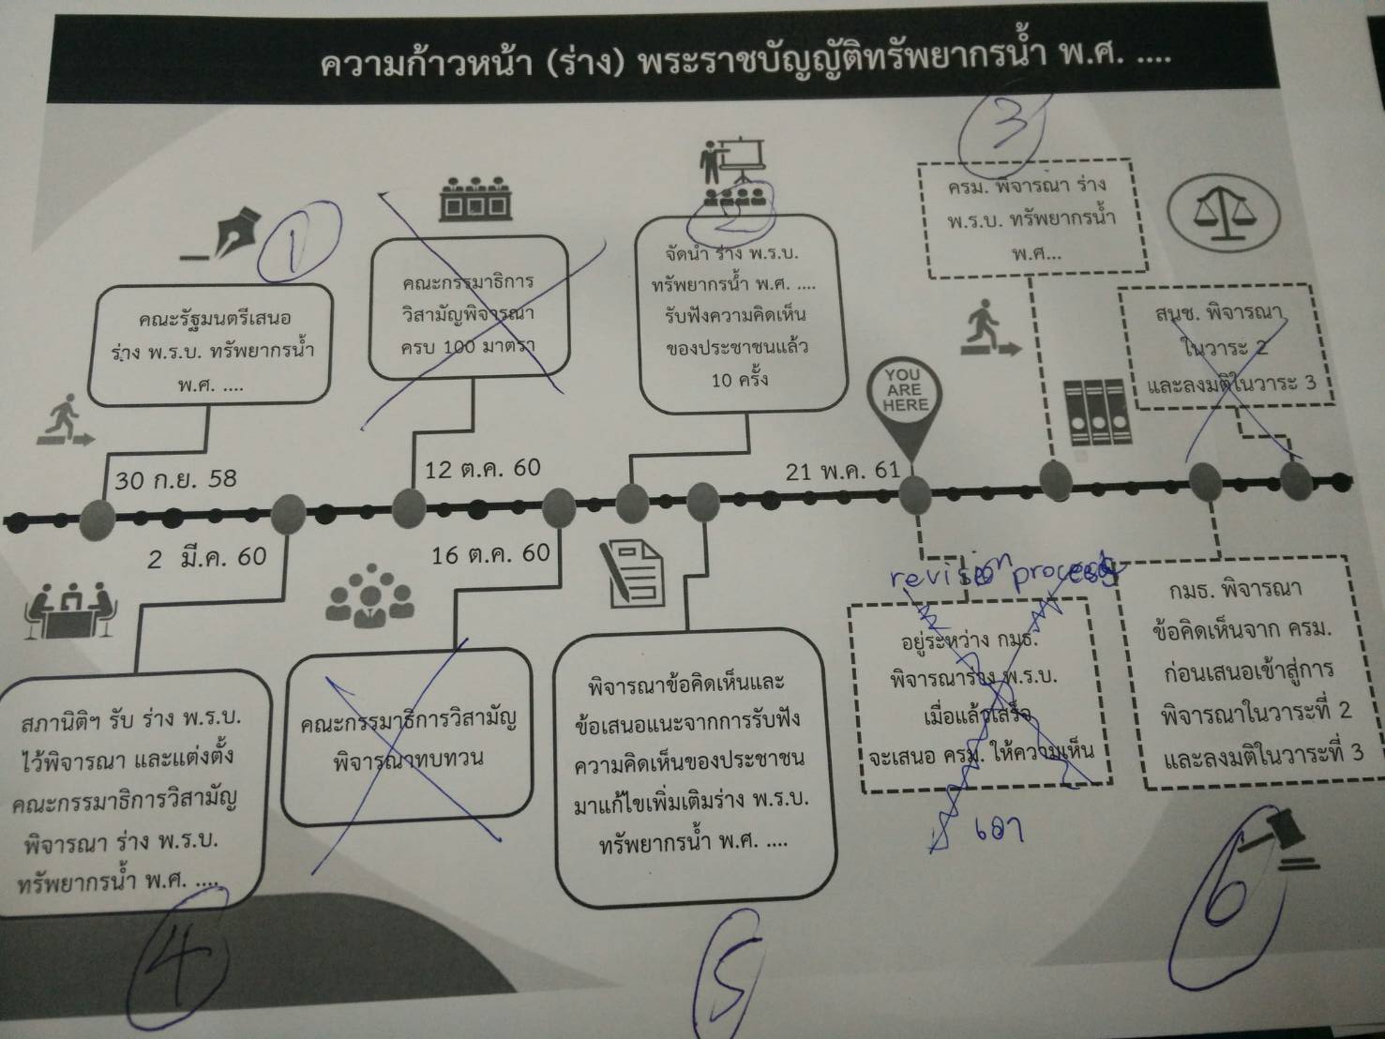
Act : Timeline of drafting a Water Act
Waiting Nong Cake
7

Slide 8
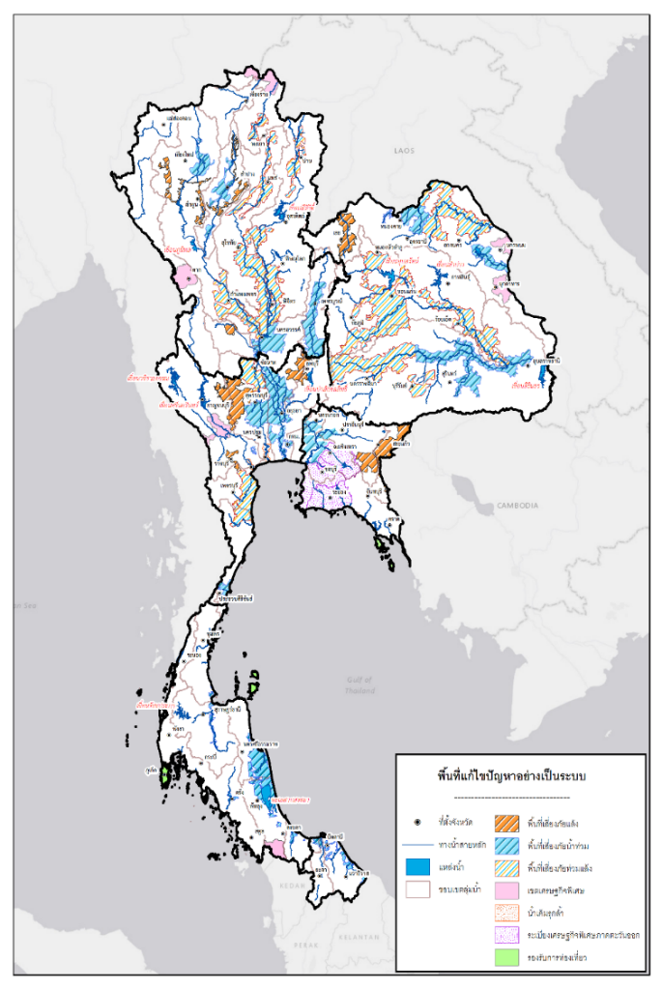
Review of Flood and Drought Resilience (Area Based)
Area-Based |  |  | Problem Area |  | Developed Area
 | Number of places | million hectare | Number of places | million hectare | Number of places | million hectare
Total Area | 66 | 4.75 | Flood 28 Drought 11 Flood and Drought 12 Saltwater intrusion 2 | 1.32 0.50 0.34 0.05 | SEZ 10 Tourist site 3 | 1.88 0.12
North | 16 | 0.98 | 14 | 0.67 | 2 | 0.31
Central | 13 | 1.13 | 12 | 0.99 | 1 | 0.15
Northeast | 12 | 0.71 | 10 | 0.50 | 2 | 0.20
East | 11 | 1.56 | 6 | 0.41 | 5 | 1.15
South | 10 | 0.35 | 7 | 0.16 | 3 | 0.19
Southern Border | 4 | 0.03 | 4 | 0.03 | - | -
Note: Consideration of Area Based must enhance public involvement and opinion into account.
* Urgent development area such as special economic zones and tourism location.
8

Slide 9

Office of the National Water Resources: ONWR
Ministerial Declaration
An urgent call for decisive action on water
17. Support the strengthening of transparent, effective, inclusive and accountable national and, where appropriate, subnational water institutional arrangements, with participation of all relevant stakeholders and consideration of local circumstances in the policy-making process, while fostering necessary partnerships, confidence building, exchange and sharing of information and experiences among public, private and civil society actors;
ONWR
Policy advisor
Regulator
Facilitator
Operator
9
Notes:
Office of the National Water Resources (ONWR) has been established under the command of the Prime Minister since October 2017. It has the responsibility to direct, review and reconcile implementing plans and budget of water-related agencies nationwide.
The establishment of ONWR is in line with the Ministerial Declaration being recently addressed at the 8th World Water Forum.
A multi-stakeholder partnerships at the national level would provide an integrated approach and help policy makers develop more effective drought risk management and decision-making strategies for Thailand for both inland and transboundary rivers.

Slide 10
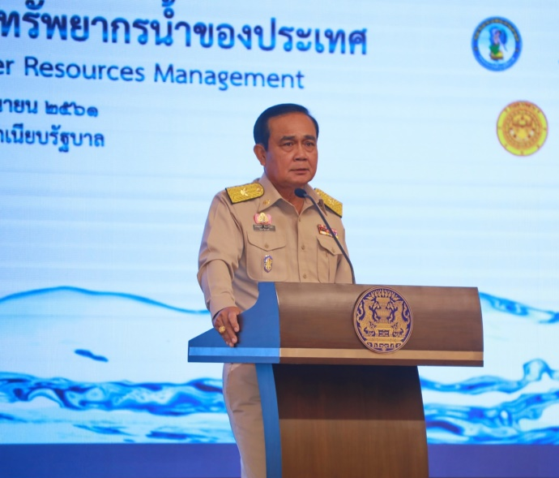
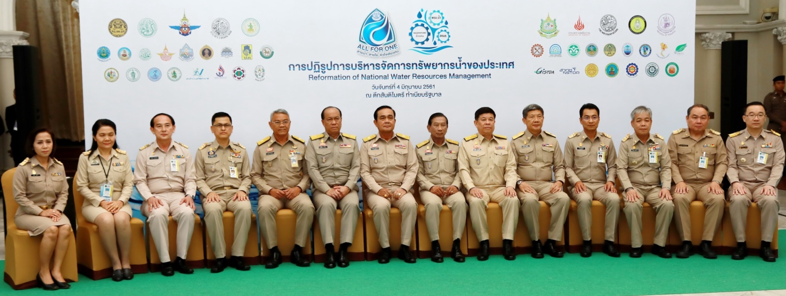
Raise awareness of Flood and drought Portal applications
4th June 2018, Government House of Thailand
Prime Minister pointed out his administration has already endorsed a total of 216 water projects worth 4 billion baht, increasing water supplies by 27 million cubic meters and covering 900,000 rai of farming and residential land, adding that 3,000 more projects are being reviewed by responsible committees
10
Notes:
On Monday 4th June 2018, Government House of Thailand. Office of the National Water Resources (ONWR) is host a seminar at Santi Maitri Building to discuss water related operations during the past four years and measures to attain water sustainability.
The prime minister says that efficiency in water management contributes to the growth of Thailand and the establishment of the Eastern Economic Corridor (EEC), consequently building trust and confidence among Thai and foreign investors.
Prime Minister pointed out his administration has already endorsed a total of 216 water projects worth 4 billion baht, increasing water supplies by 27 million cubic meters and covering 900,000 rai of farming and residential land, adding that 3,000 more projects are being reviewed by responsible committees.

Slide 11
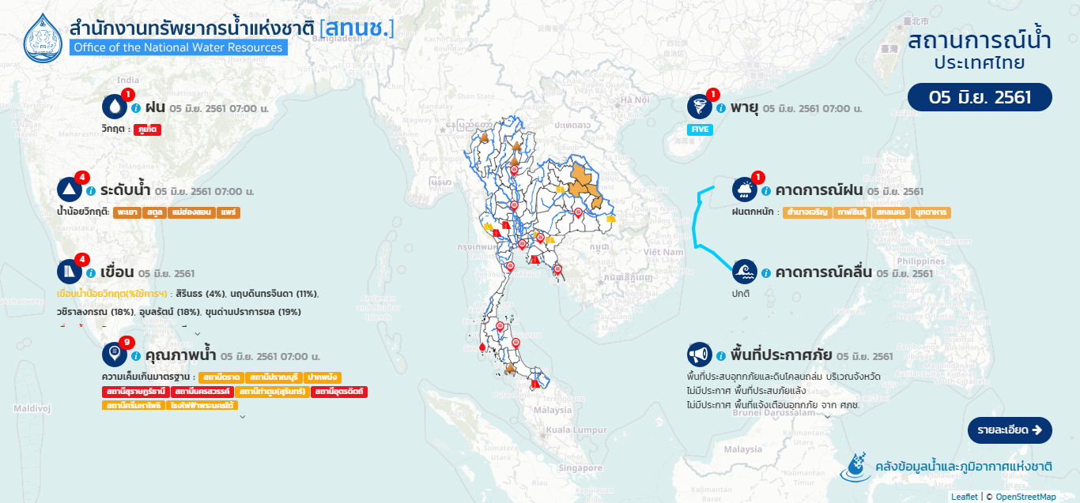
Management Tools : Flood and drought
Information / situation
Thailand flood and drought information system
Thailand early warning system
11
Notes:
Water Situation of Thailand is the main of ONWR website for monitoring and

Slide 12
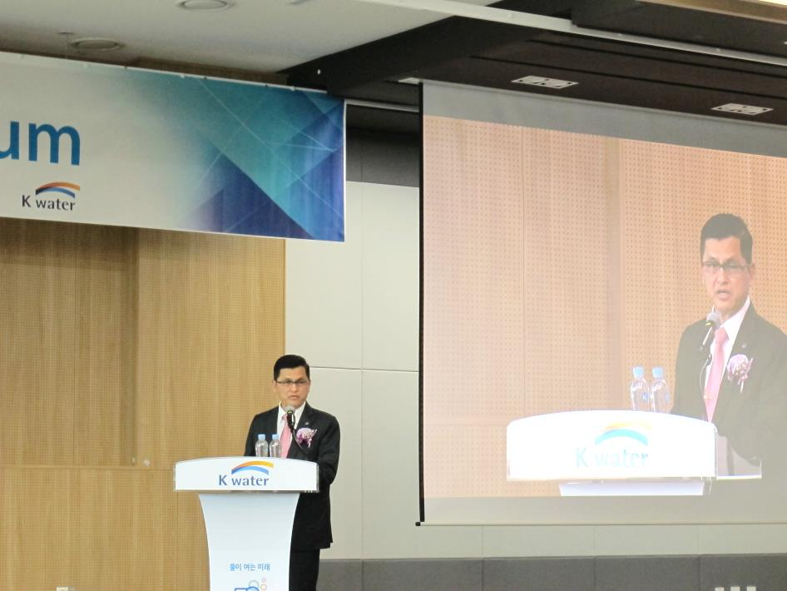
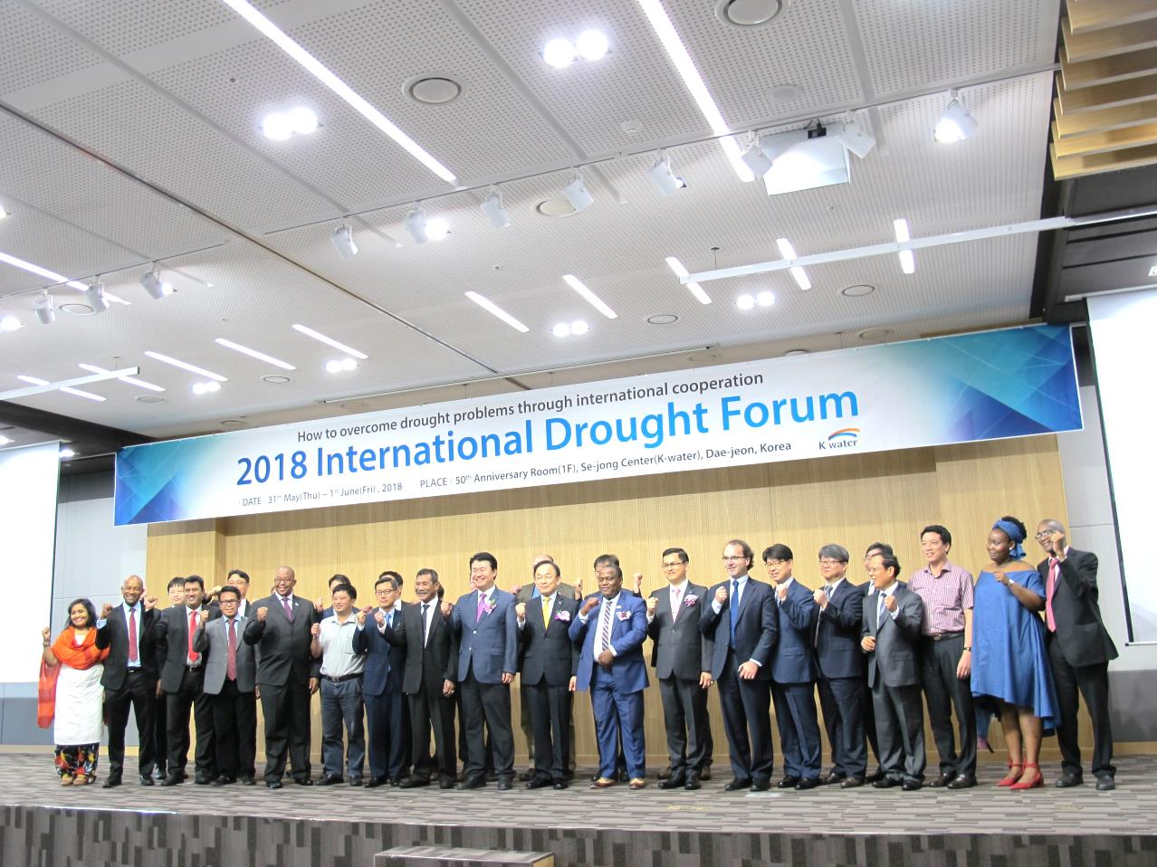
Management Tools : Flood and drought
31st May 2018 , Daejeon, Republic of Korea
Secretary – General of ONWR is a keynote speaker for the 2018 International Drought Forum. Outcome of this event is sharing the practical and insightful knowledges, our experiences, and networks in solving drought related issues. Under the main theme “How to overcome drought problems through international cooperation”
12
Notes:
On 31st May 2018 at Daejeon, Republic of Korea
Secretary – General of ONWR is a keynote speaker for the 2018 International Drought Forum.
Outcome of this event is sharing the practical and insightful knowledges, our experiences, and multi-stakeholder partnerships in solving drought related issues. Under the main theme “How to overcome drought problems through international cooperation”.
The development of a single combined flood and drought tools is needed. The information must consist of key and ancillary tools from different agencies.
The set of universal drought tools will trigger a more responsive prediction and action as it has a potential to reduce incorrect decisions.
Thus, we should call upon the multi-stakeholder partnerships. Not only at the national level, but also at the regional and where possible at the global levels in order to achieve more accountable and transparent in flood and drought management and the implementation of 2030 agenda for sustainable development.

Slide 13


Thank you
http://www.onwr.go.th/
http://daily-report.onwr.go.th/thaiwater30/

